Slide 1

P3 Presentation
public class TeamD

Slide 2
Team Intro
Nick Cunningham
Dakota Golightly
Victor Mumford
Sai Donepudi

Slide 3
Overview
Summary
Description of Omega Chess
Development Process and Challenges
Design Decisions
Demo
Lessons Learned

Slide 4
Project Review - Summary
Develop web application to play Omega Chess – our assigned version of "XGame" and a variant of chess played with additional pieces/moves
Chose to focus on features, with a simple UI for navigation
Implemented 14 user stories, allowing user to register, login, play games, view match history, etc.
Developed based on customer briefing
Faced several exterior impediments, but ended with a usable product that we would have loved to develop more fully with more time

Slide 5
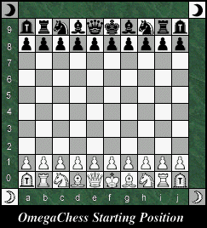
Description of Omega Chess
Omega Chess is much like standard chess, but with these key differences:
The board is 10x10 (standard chess is 8x8), but also with four additional corner squares.
There are two new units: the wizard, and the champion.
The wizard can either move to diagonal squares, or move in a 3x1 L shape, much like the Knight’s 2x1 L.
The champion can move 1-2 spaces in the cardinal directions, or exactly two spaces in the diagonal directions.
There are two of these new units per side. The Champions are put in the extra column spaces next to the Rooks, and the Wizards are put in the extra corner spaces.
Pawns can move 1-3 spaces forward on their first turn instead of 1-2 spaces.
Image source: https://www.chessvariants.com/large.dir/omega/rules.html

Slide 6
Development Process and Challenges
Process
Project based on Spring Boot/Maven for an MVC (model-view-controller) framework
Used IDE-agnostic practices to allow maximum flexibility on development team
Agile-based development with 3x weekly scrums, four total sprints, and three milestones/deliveries
Task management via ZenHub
Automated testing via Jest and Junit
Challenges
Lost two teammates in first week – operated as a team of four
Three teammates encountered significant personal setbacks (COVID, wildfire evacuations, and ill family members) that hindered progress in P2/P3 milestones
Differing work/school schedules posed collaboration issues that we resolved

Slide 7
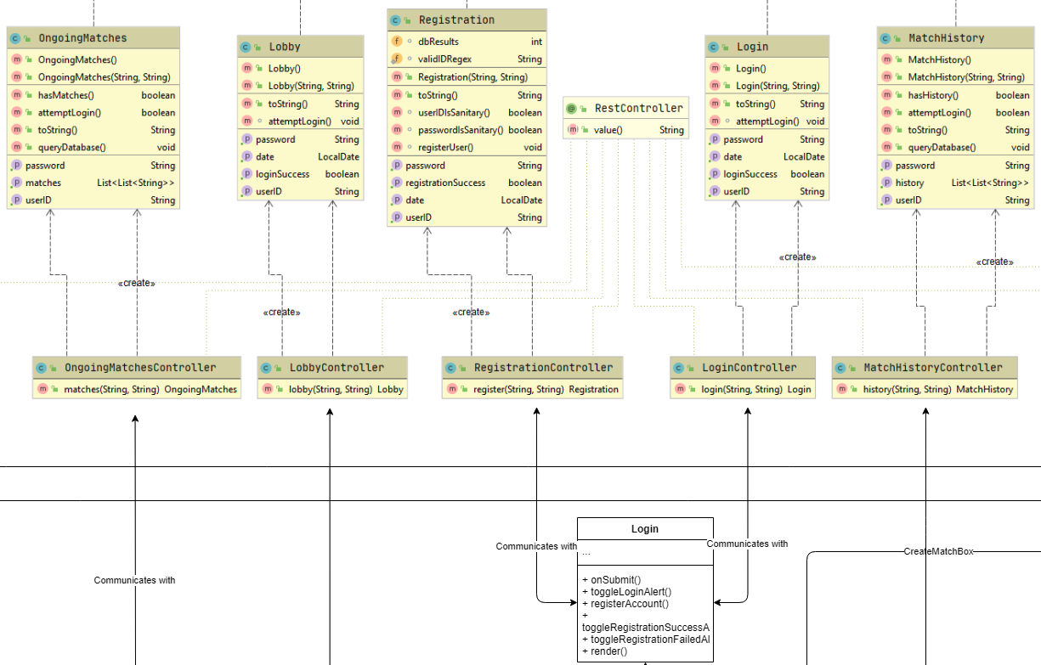
Design Decisions
Model-View-Controller (MVC) Framework
All pages have Java backend (model), JavaScript/React frontend (view), and Java classes that map frontend requests to backend objects (controller)
Includes Registration/Login, Lobby, Board display, Ongoing Matches, and Match History pages
This allows for extensibility for new features and simplified development
Sample of MVC Framework in Class Diagram

Slide 8
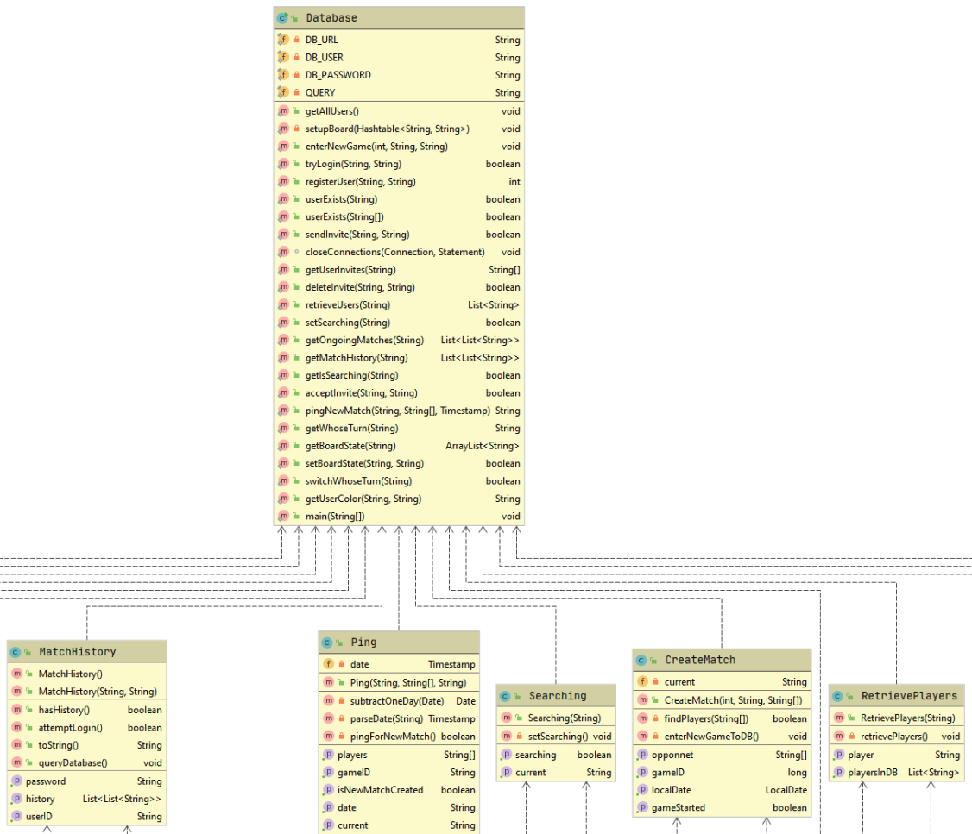
Design Decisions
Database implemented in MySQL and hosted on CS machines
Communication is handled via one Java class (singleton pattern)
Each class that needs database access has its own method in this file
This adds security and ease of debugging with a single point of access
Sample of Database Linkages from Class Diagram

Slide 9
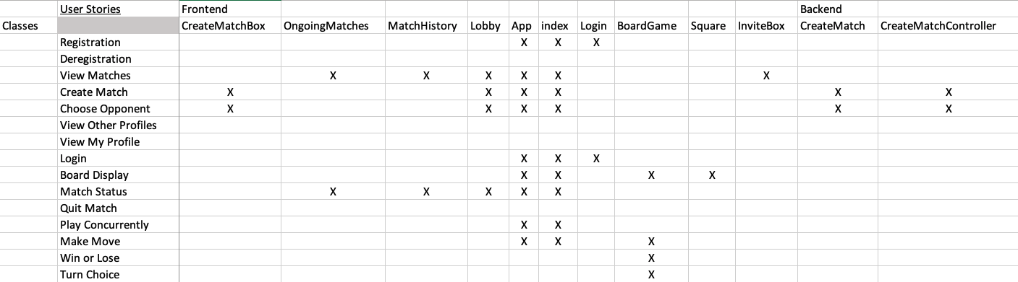
Design Decisions
Testing via Jest and Junit
Created tests to satisfy acceptance criteria from user stories
Automated tests created for as many objects as possible
Used tests that would not alter the database
Broken up into frontend and backend so we could implement each without the other needing to be complete
Sample of Traceability Link Matrix for Test Cases

Slide 10
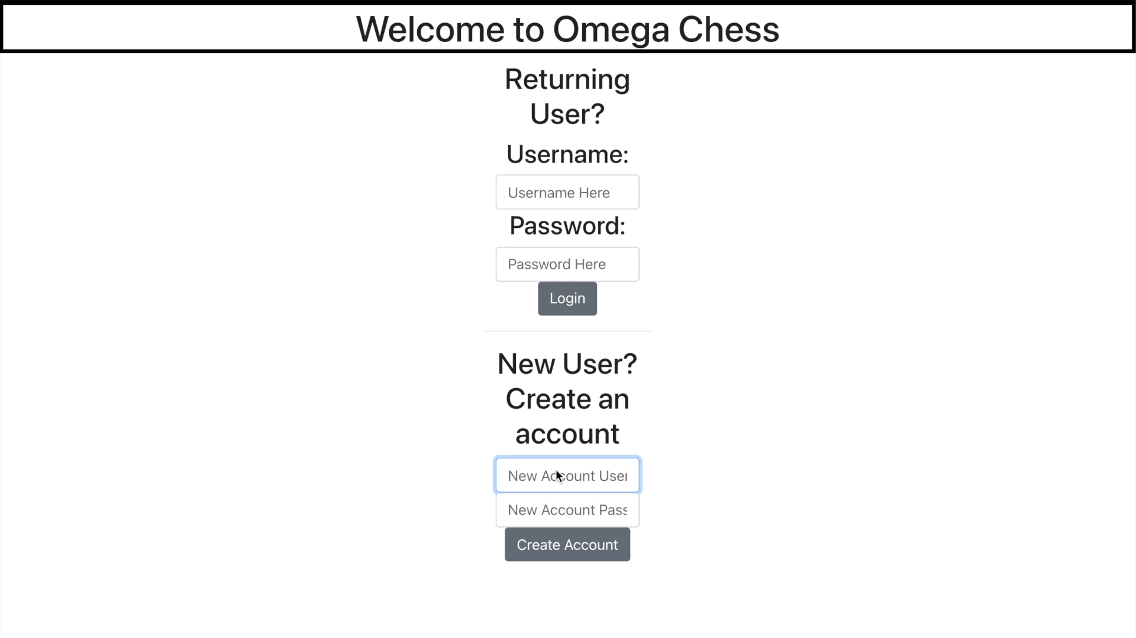
Demo

Slide 11
Lessons Learned
Start early, even if you believe a task will be easy, because something will almost certainly complicate it
Take time at the beginning of the project to do a thorough outline of the expected classes, etc.
Design in a way that will accommodate changes to this outline as easily as possible
Use the tools at your disposal (UML diagrams, development manuals, etc.) to overcome blockers
Be flexible, especially when working remotely
Play to your strengths as a team; if a team member is good at Java or enjoys it, they will likely perform much better at those tasks

